Slide 1
Factors influencing the worldwide Obesity epidemic
Barrie M Margetts

Slide 2
Outline
Current situation: focus on sugar and processed foods
Recent study in South Africa
Global drivers and challenges
Way forward

Slide 3
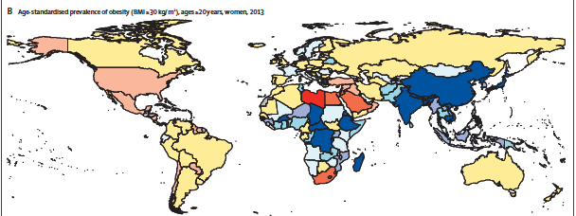


Slide 4
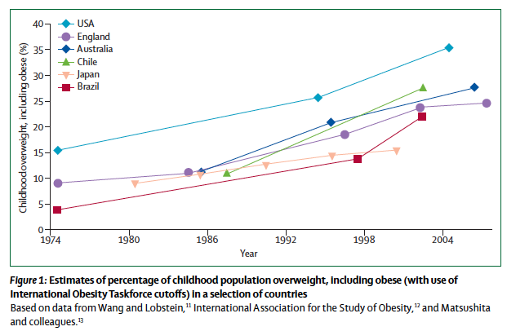
Swinburn et al 2011 Lancet

Slide 5
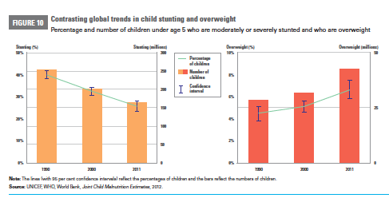

Slide 6
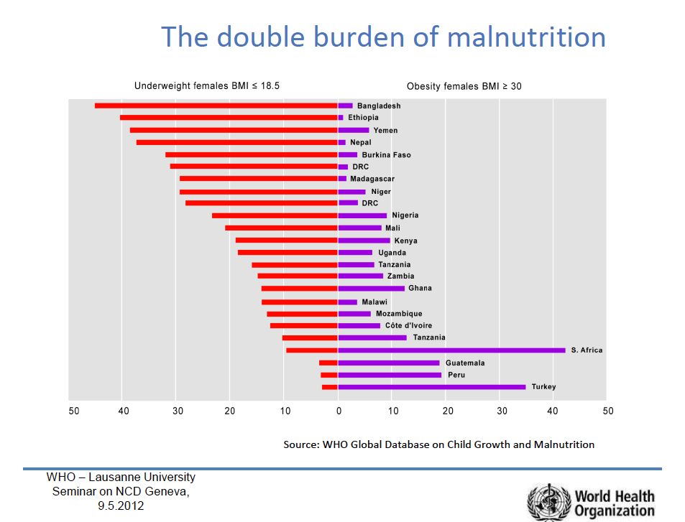

Slide 7
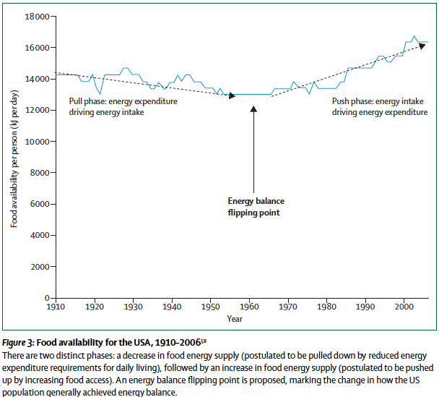

Slide 8
Food security and health
  Getting enough of the right foods amongst most vulnerable
Continued double burden requires action to improve quality of diet while reaching optimal energy intake
  Need nutrient rich sources of food
    Avoid high fat, salt and added sugar foods
    Influence of global food system driving consumption

Slide 9
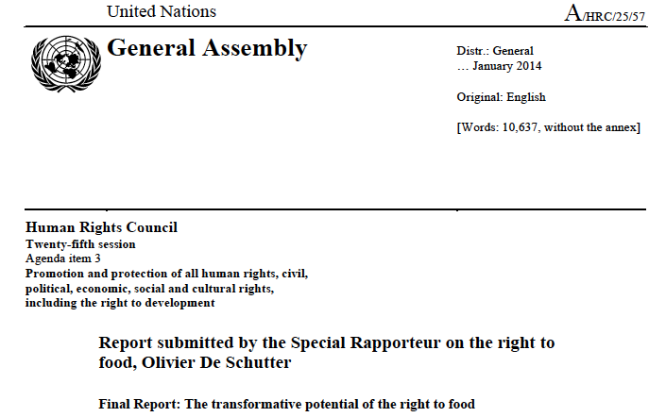

Slide 10
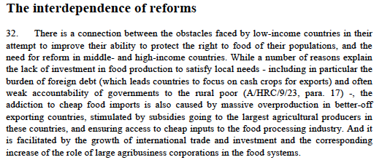

Slide 11
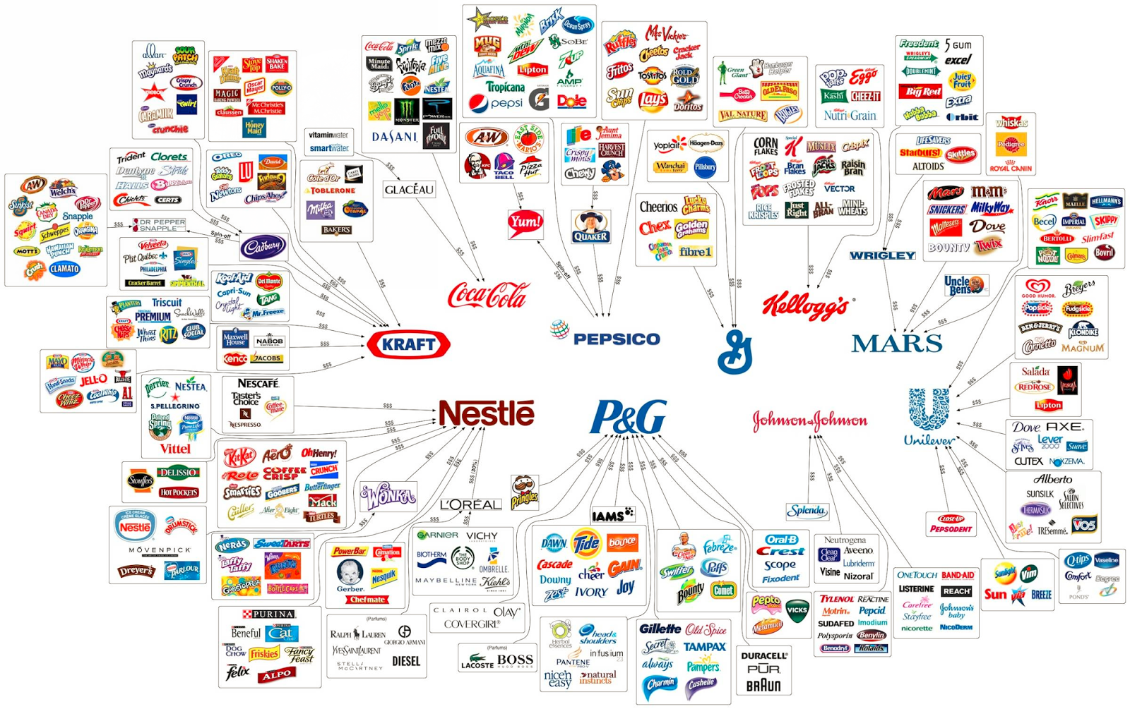
10 Corporations Control Almost Everything You Buy — This Chart Shows How - PolicyMic.webarchive

Slide 12
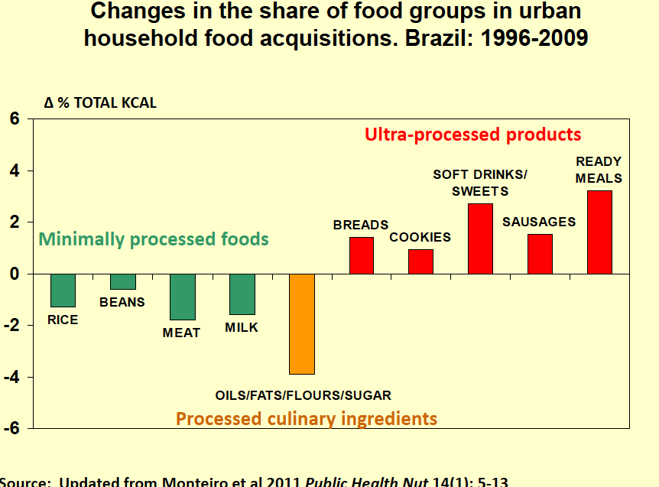

Slide 13
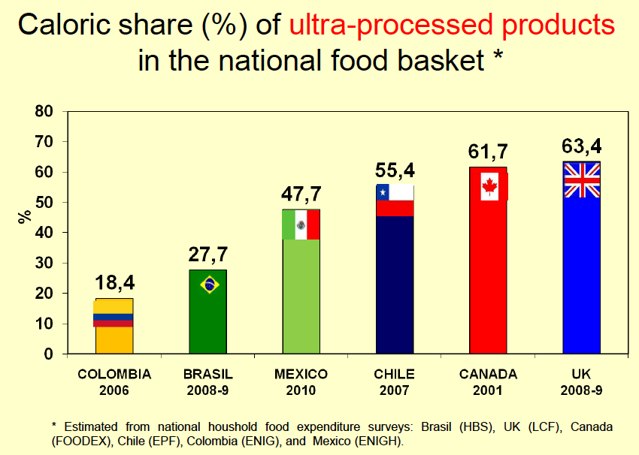

Slide 14
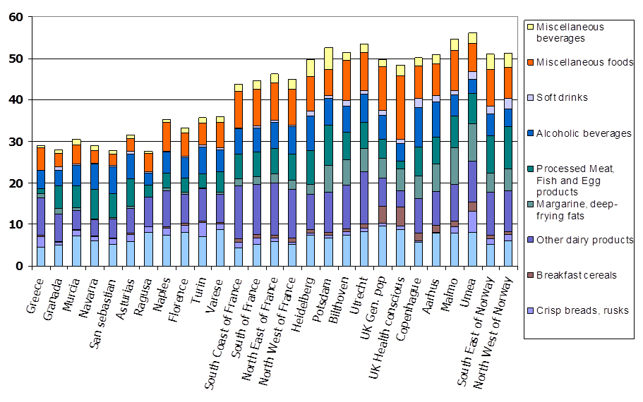
Percent energy from selected food groups
Slimani et al 2009, EPIC Cohorts

Slide 15
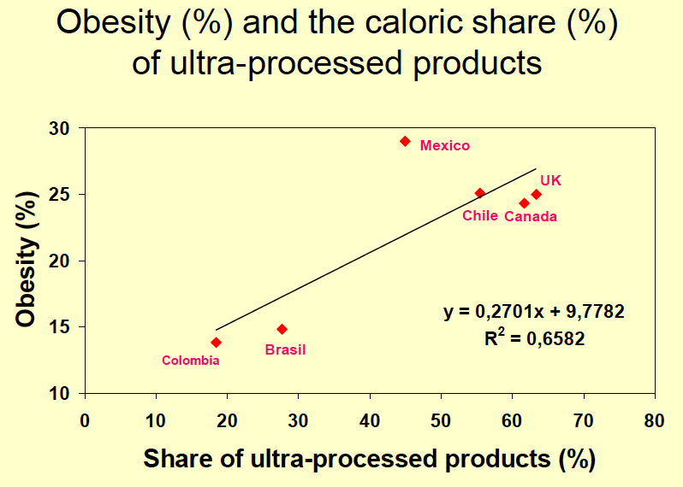

Slide 16
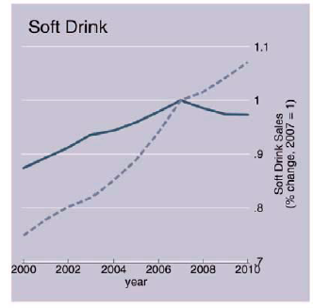
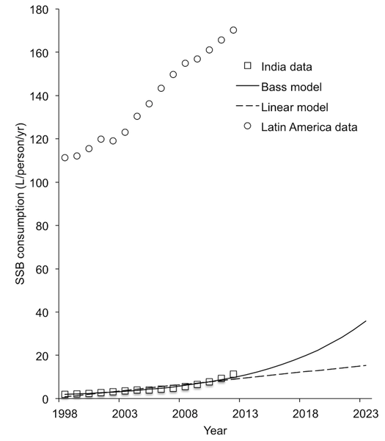
Trends in soft/sweetened drink consumption
LMICs
Basu S, Vellakkal S, Agrawal S, Stuckler D, et al. (2014) Averting Obesity and Type 2 Diabetes in India through Sugar-Sweetened Beverage Taxation: An Economic-Epidemiologic Modeling Study. PLoS Med 11(1): e1001582. doi:10.1371/journal.pmed.1001582
http://www.plosmedicine.org/article/info:doi/10.1371/journal.pmed.1001582
Stuckler and Nestle 2013

Slide 17
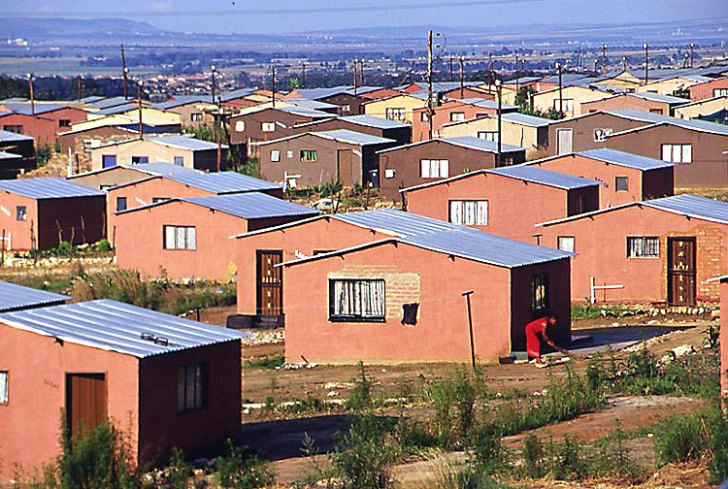
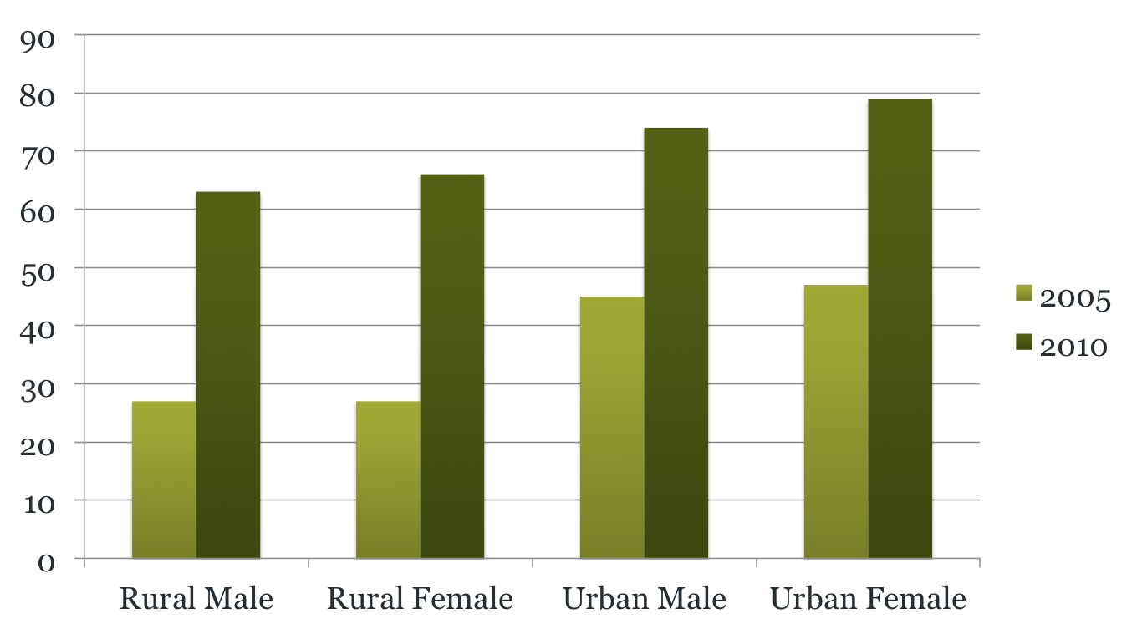
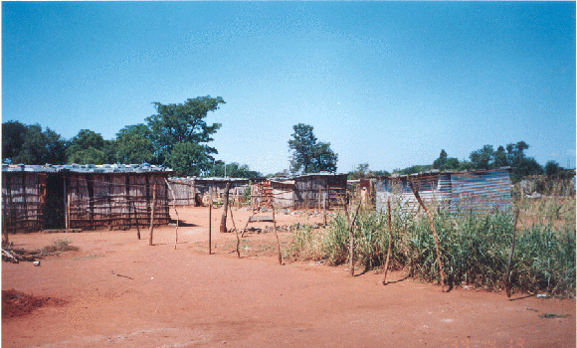
Trend: Added Sugar Intake: South Africa
Vorster et al 2014
UK about 95g per day

Slide 18
% Consuming sucrose sweetened beverages (SSBs)

Slide 19
Changes in BMI 2005-2010 by % energy added sugar

Slide 20
What to do?
Is it possible to stop the rise in obesity worldwide?
What are the most effective approaches?
Need to think about and understand the deep underlying causes and address these drivers
  Primary prevention v tertiary prevention

Slide 21
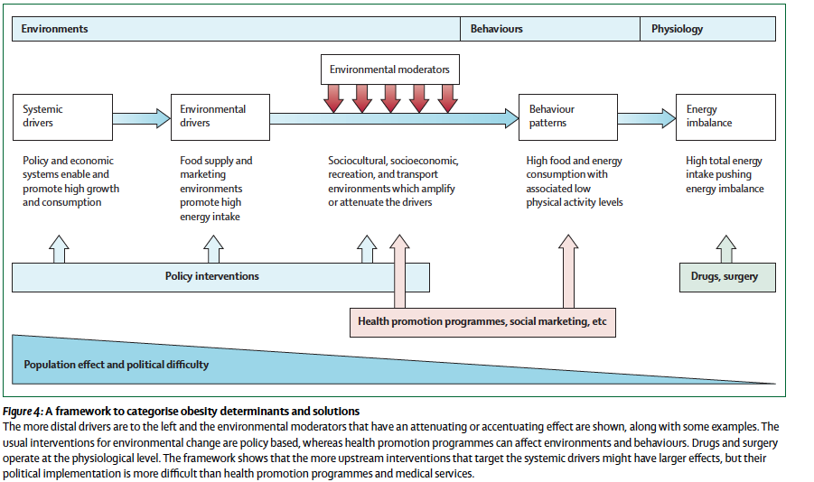

Slide 22
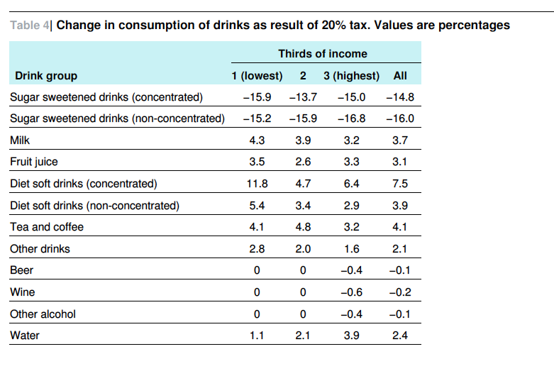
Briggs et al 2013 BMJ

Slide 23
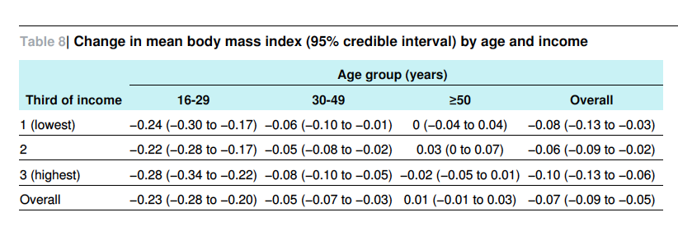
Conclusion
“A 20% tax on sugar sweetened drinks would lead to a
reduction in the prevalence of obesity in the UK of 1.3% (around 180
000 people). The greatest effects may occur in young people, with no
significant differences between income groups. Both effects warrant
further exploration. Taxation of sugar sweetened drinks is a promising
population measure to target population obesity, particularly among
younger adults”.

Slide 24
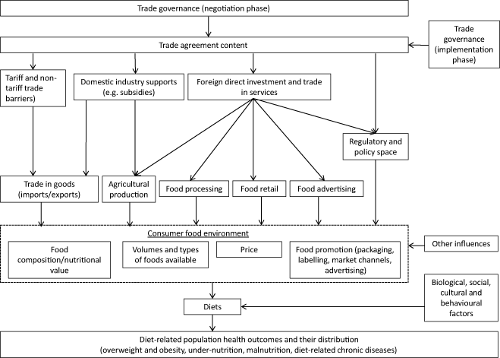
Monitoring the impacts of trade agreements on food environments
Obesity Reviews
pages 120-134, 17 SEP 2013 DOI: 10.1111/obr.12081
http://onlinelibrary.wiley.com/doi/10.1111/obr.12081/full#obr12081-fig-0001
Notes:
Conceptual framework for the direct links between trade agreements, food environments, diets and obesity/non‐communicable diseases outcomes. Adapted from Hawkes (p. 37) .
© IF THIS IMAGE HAS BEEN PROVIDED BY OR IS OWNED BY A THIRD PARTY, AS INDICATED IN THE CAPTION LINE, THEN FURTHER PERMISSION MAY BE NEEDED BEFORE ANY FURTHER USE. PLEASE CONTACT WILEY'S PERMISSIONS DEPARTMENT ON PERMISSIONS@WILEY.COM OR USE THE RIGHTSLINK SERVICE BY CLICKING ON THE 'REQUEST PERMISSION' LINK ACCOMPANYING THIS ARTICLE. WILEY OR AUTHOR OWNED IMAGES MAY BE USED FOR NON-COMMERCIAL PURPOSES, SUBJECT TO PROPER CITATION OF THE ARTICLE, AUTHOR, AND PUBLISHER.

Slide 25
Summary points
There is now evidence from Hungary, France, Denmark, Norway, Brazil and Mexico that shows with political commitment fiscal policies can be implemented, and can have an impact.
Need to resist the undue influence on policy of the vested interests of ‘Big Food’
Voluntary codes have not been shown to work:
  Either in terms of reformulation
  Or compliance with codes of marketing
    Exploit loopholes eg web-based games etc are used instead of TV adverts, partly because the companies do not keep their promises.

Slide 26
Reversing the global trends
Halt spread of ultra high processed foods and sweetened beverages- major concern in LMICs
Need legislation and fiscal measures to change supply side; changing demand side alone will not work
International codes/structures required now because of nature of food supply system: driven by health not profit alone
Population/prevention needs to be strengthened and to balance efforts at individual/treatment level

Slide 27


